Slide 1
Algorithms 5800 Final Project: Path Finding Algorithms Comparison
Present by Group 11:
Xiaofeng Zhao, Min Xu, Liu Yang

Slide 2
TABLE OF CONTENTS
01
02
03
04
INTRODUCTION
THREE ALGORITHMS
Introduction of our project， background and motivation
Summary of each path finding algorithm
COMPARISONS
APPLICATIONS
Comparisons of three algorithms including demo and complexity
Real world applications of these algorithms
CONCLUSION
05
What we have learned from this project

Slide 3
01
INTRODUCTION

Slide 4
Why This Topic?
Feng
Passion for Game development. Pathfinding plays an integral role in providing smooth and responsive gameplay. Explore how different algorithms handle pathfinding.
QUESTION & SCOPE
JENNA DOE
Min
Background in finance, the optimization and path minimization of different algorithms can be applied in portfolio optimization and rebalancing.
What is the most efficient way to find the shortest path in a 2D game/map environment?
Focus on comparing the efficiency of three pathfinding algorithms (Dijkstra, A*, and Jump Point Search)
You can talk a bit about this person here
Liu
Previously worked as a product manager at a company involved in route planning and map navigation. Eager to explore advanced path finding algorithms.

Slide 5
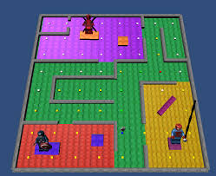
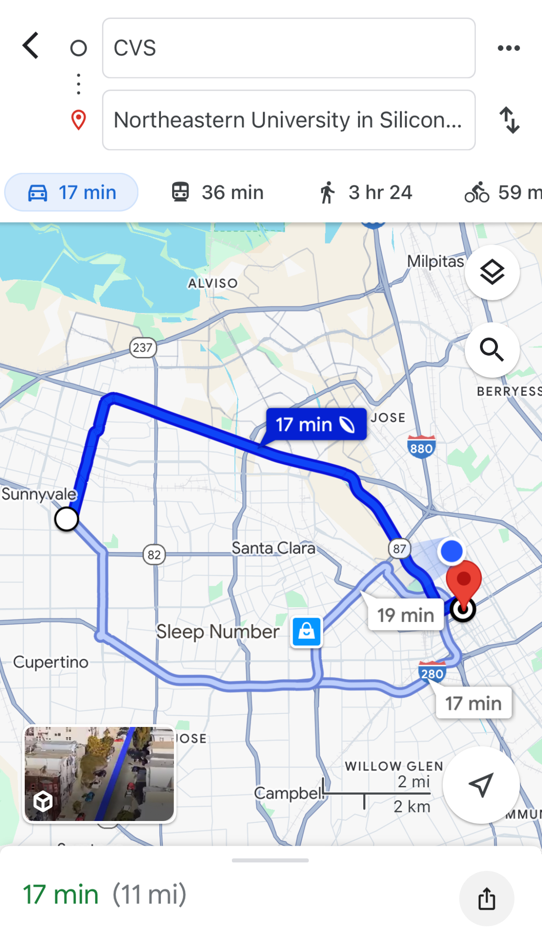
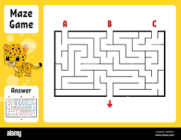

Slide 6
Why This Topic?
Feng
Passion for Game development. Pathfinding plays an integral role in providing smooth and responsive gameplay. Explore how different algorithms handle pathfinding.
QUESTION & SCOPE
JENNA DOE
Min
Background in finance, the optimization and path minimization of different algorithms can be applied in portfolio optimization and rebalancing.
What is the most efficient way to find the shortest path in a 2D game/map environment?
Focus on comparing the efficiency of three pathfinding algorithms (Dijkstra, A*, and Jump Point Search)
You can talk a bit about this person here
Liu
Previously worked as a product manager at a company involved in route planning and map navigation. Eager to explore advanced path finding algorithms.

Slide 7
02
THREE ALGORITHMS

Slide 8
PRINCIPLES OF 3 ALGORITHMS
1. Dijkstra
A greedy algorithm that iteratively selects the unvisited node with the shortest distance from the start, updating its neighbors' shortest paths.
2. A*
Enhances Dijkstra's algorithm by using a heuristic function to guide the search, prioritizing nodes based on f(x) = g(x) + h(x), where:
g(x): Cost from the start node to the current node.
h(x): Estimated cost from the current node to the goal (heuristic).
3. Jump Point Search
"Jumps" over intermediate nodes in straight paths to focus only on critical points (e.g., turning points, goal-facing obstacles). Same as A*, using a heuristic function.

Slide 9
SUMMARY OF 3 ALGORITHMS
Algorithm | Heuristic | Use Cases | Efficiency
Dijkstra | None | Weighted graph, all paths | Slow, explores all nodes
A* | Required (e.g., Manhattan or Euclidean distance). | Targeted pathfinding | Faster, focuses on the goal
Jump Point Search (JPS) | A*-style heuristic | Optimizes A* for grid-based maps by skipping unnecessary nodes | Fastest on grids, skips nodes

Slide 10
03
COMPARISONS

Slide 11
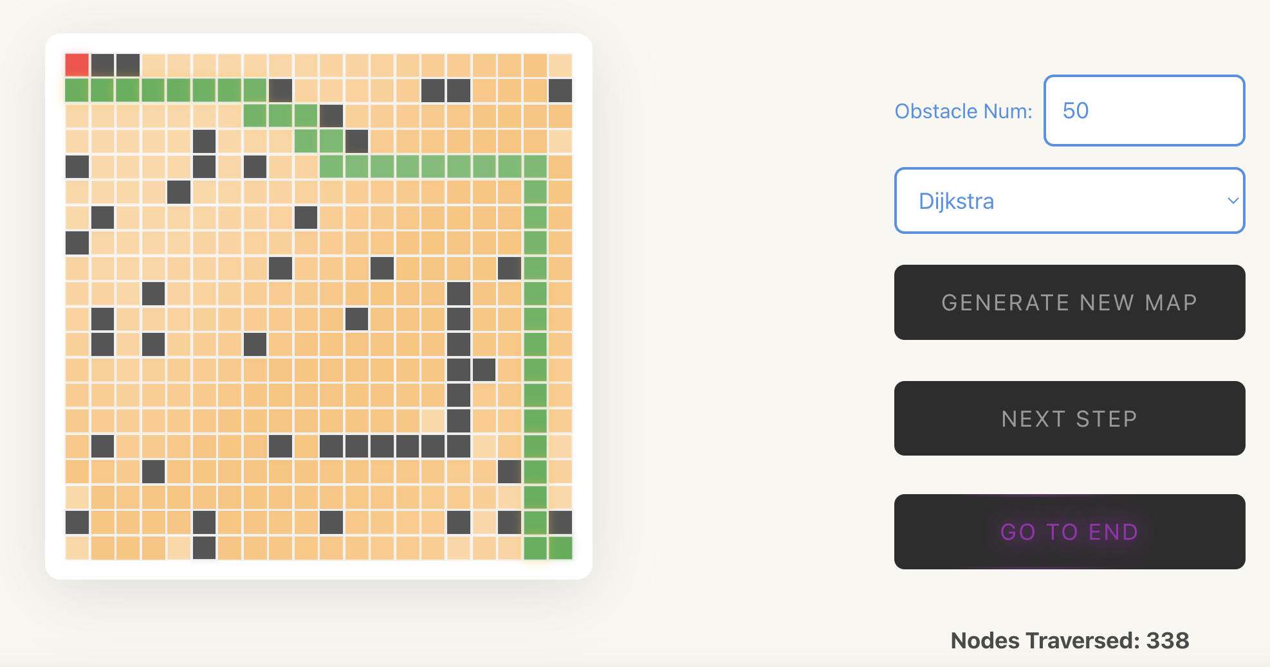
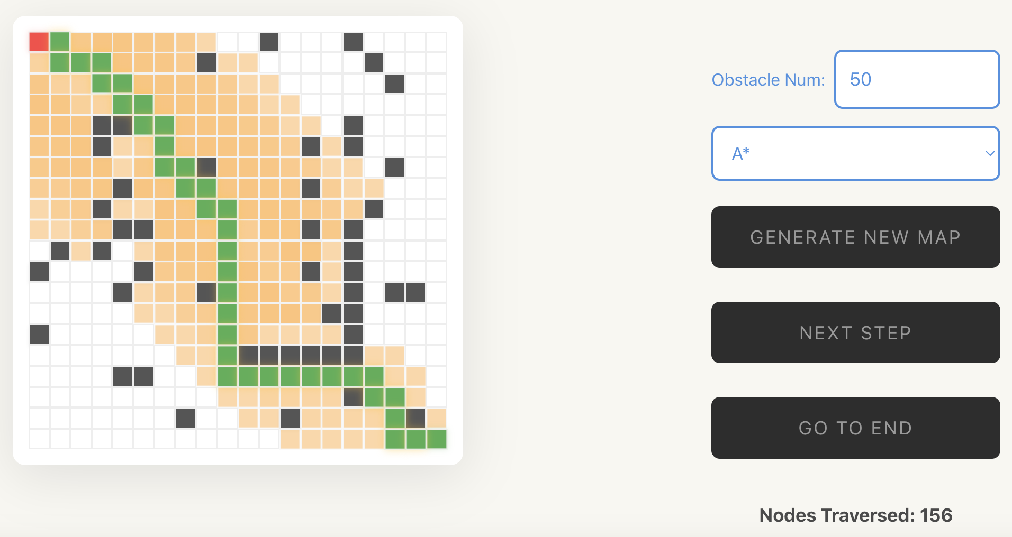
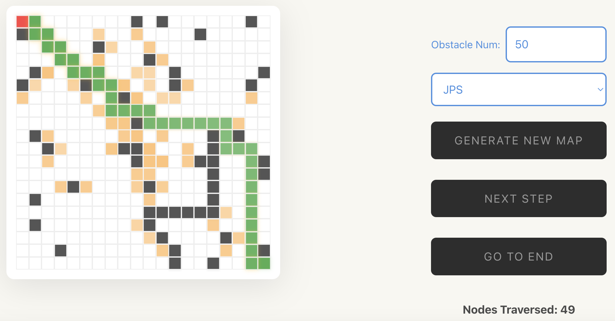
Dijkstra
Slow, explores all nodes
No heuristic function
Faster, focuses on the goal
Prioritizing nodes based on heuristic function
A*
Fastest on grids, skipping unnecessary nodes
Focus only on critical points
A*-style heuristic
JPS
Notes:
Hyperlink to our demo of each picture!

Slide 12

1. Time Complexity
Dijkstra:
Without a priority queue: ${O(V)}^{2}$, where $V$ is the number of nodes.
With a priority queue (e.g., Fibonacci heap): $O(E+VlogV)$, where $E$ is the number of edges.
A*:
In the worst case: Similar to Dijkstra: $O(E+VlogV)$
With a good heuristic: Time complexity reduces as fewer nodes are explored.
JPS:
Grid maps: $O(nlogn)$, where n is the number of nodes in the grid.
Notes:
Hyperlink to our demo of each picture!

Slide 13

2. Space Complexity
Dijkstra: $O(V)$, to store distances and visited nodes.
A*: $O(V)$, but additional space is used for the heuristic and open/closed lists.
JPS: $O(n)$, similar to A* but with reduced memory overhead due to skipping unnecessary nodes.
Notes:
Hyperlink to our demo of each picture!

Slide 14
COMPARISON OF 3 ALGORITHMS
Algorithm | Advantages | Disadvantages | Best Use Case
Dijkstra | - Works with all non-negative weighted graphs | - Explores all paths unnecessarily - Slower without a heuristic | Large, weighted graphs where shortest paths to all nodes are required (e.g., road networks)
A* | - Highly efficient with a good heuristic. - Focuses on paths leading to the goal | - Efficiency depends on heuristic - high memory usage | With a clear goal and a good heuristic (e.g., robotics)
Jump Point Search (JPS) | - Highly optimized for grid maps. - Skips redundant nodes, speeding up searches | - Only works for uniform-cost grids - Complexity is higher than A* | Grid-based maps where speed and efficiency are critical (e.g., games)
Notes:
Hyperlink to our demo of each picture!

Slide 15
05
APPLICATIONS
Real world applications of these algorithms

Slide 16
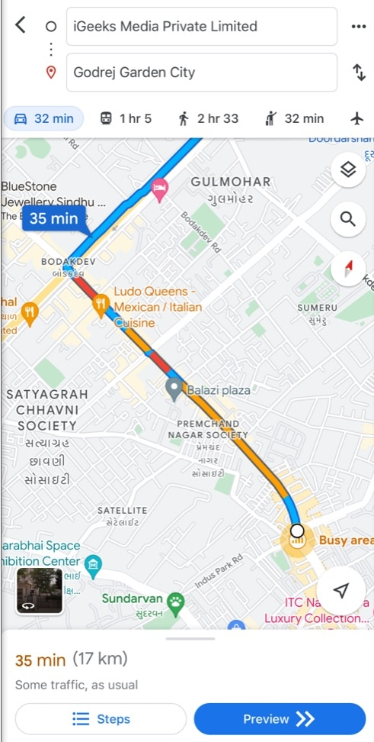
APPLICATION - Dijkstra
Google Maps
Why Dijkstra’s Algorithm is Relevant to Google Maps ?
Handles weighted graphs where roads have weights (e.g., distance, travel time).
Guarantees the shortest path by systematically exploring all possible routes from a starting point.
Shortest Route
Use Case: Finding the shortest or fastest route between two locations.
How: Dijkstra evaluates all possible routes and identifies the one with the least cumulative weight.
Real-Time Updates Use Case
Use Case: Recalculating paths dynamically when road conditions change (e.g., accidents, traffic jams).
How: Updates edge weights (e.g., increased travel time) to adjust the route.

Slide 17
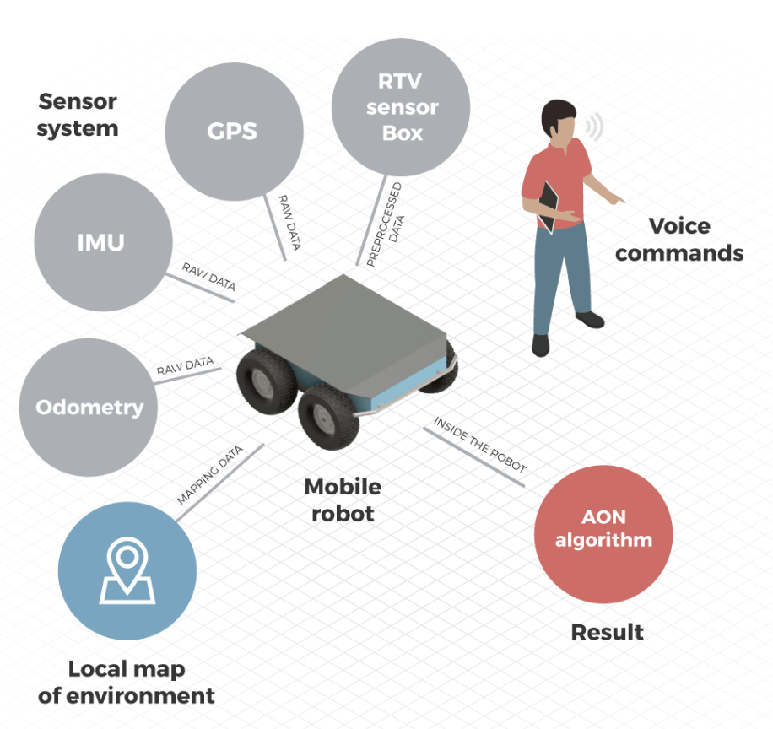
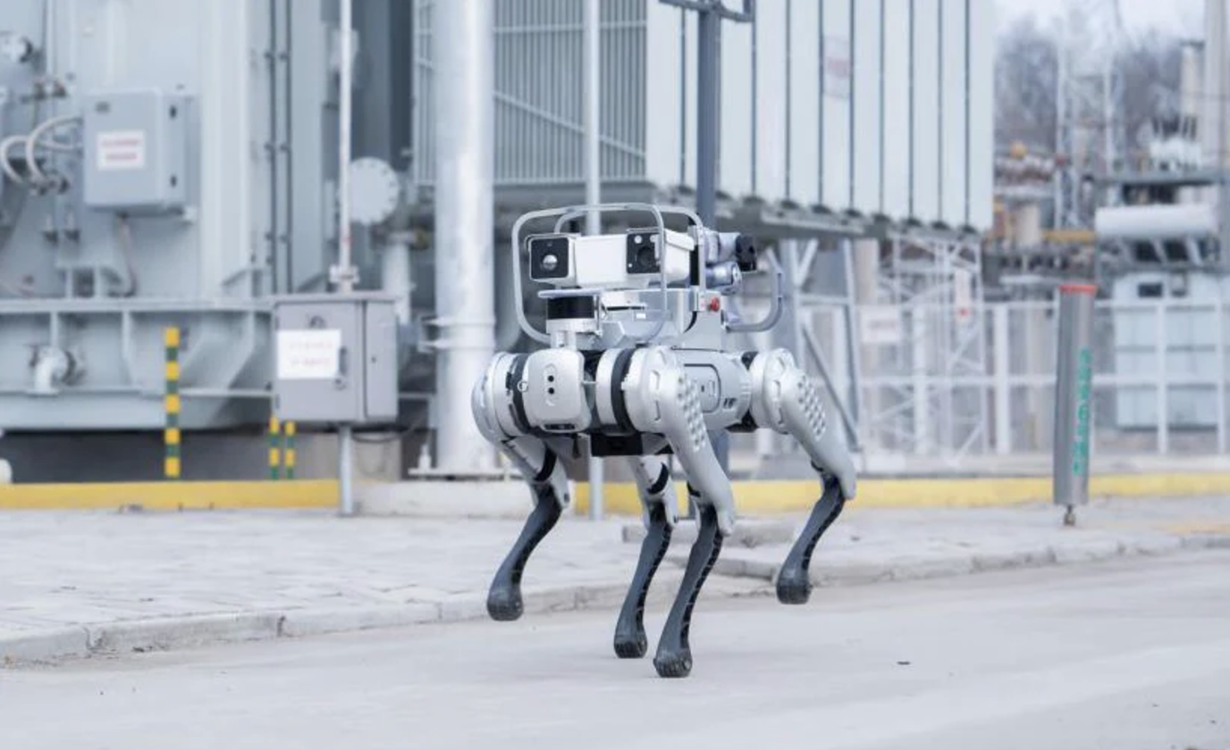
APPLICATION - A*
Robotics
Why A is Used in Robotics?
Robotics often involves navigating through complex environments filled with obstacles.
The robot's task is to find the most efficient a target destination.
Warehouse Robots
Use Case: Optimizing the movement of robots in warehouses for item retrieval or delivery.
Example: Amazon warehouse robots efficiently picking and delivering items.
Rescue Robots
Use Case: A* guides robots through rubble or debris to find victims, avoiding unsafe areas..
Example: A robot navigating a collapsed building to reach survivors.

Slide 18

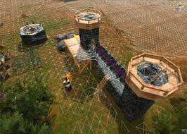
APPLICATION - JPS
1. Optimization Algorithms
Financial Optimization
Use Case: Applications requiring large-scale combinatorial optimization.
How: Skips less promising paths, focusing only on the most likely optimal solutions.
Example: Portfolio rebalancing
2. Video Games
NPC (Non-Player Character) Pathfinding
Use Case: Efficient movement of characters in games, such as strategy, RPGs, or simulation games.
How: The game map is represented as a grid. JPS skips redundant nodes.
Example: In a real-time strategy game, units quickly navigate across large maps to reach their destination while avoiding obstacles.

Slide 19
06
CONCLUSION

Slide 20
What We Have Learned
Understanding Pathfinding Algorithms:
Dijkstra, A*, and JPS, their complexities, advantages and disadvantages.
Learned the impact of heuristics and optimizations on performance.
Practical Coding Experience:
Front-End and Back-End Coordination: Learned how to visualize a 2D grid for pathfinding, including interactive elements for user input.
Optimal Path Storage and Description: Store the pathfinding process step-by-step, developed methods to represent the optimal path.
Real-World Applications:
Explored the use of pathfinding in navigation, robotics, gaming, and finance.
Summary
Dijkstra: Multi-path, weighted graphs.
A*: Heuristic-driven goal searching.
JPS: Optimized grid traversal.
Notes:
Hyperlink to our demo of each picture!

Slide 21
THANKS!
Q&A

